Slide 1
BCOG 100
Mind and Brain Lecture 1: The Mind-Body Problem

Slide 2

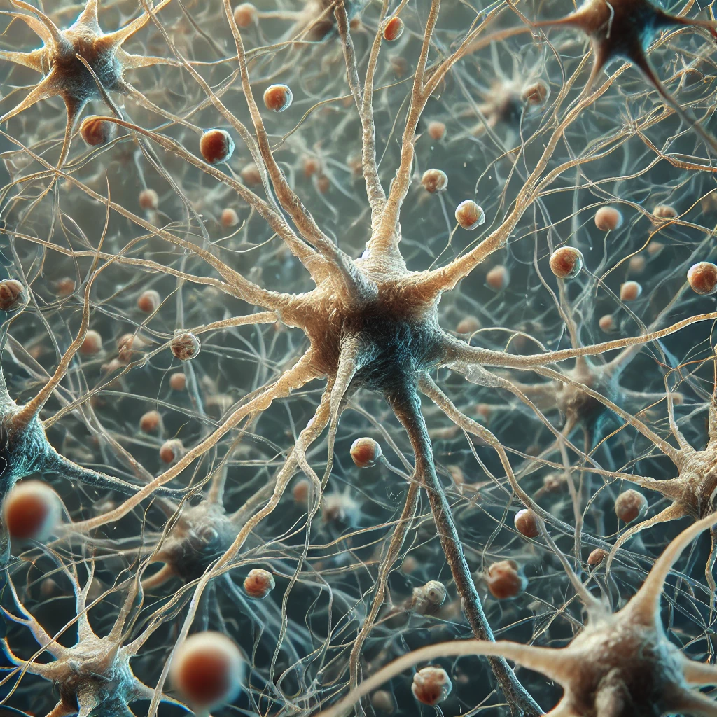
Mind-Body Problem
Mmm, Oranges. I’m hungry.
Notes:
Last time we talked about a how there are all these amazing things the human brain does. Like how we can look at this picture, and instantly recognize what is there. Maybe some of you even feel like you can smell or taste those oranges.
We also talked about a wide range or other phenomena, like memory, language, social cognition, and planning and thinking, that the human mind can do.
And we talked about how its an amazing scientific challenge it is that we trying to explain and understand all of these complex behaviors in terms of these little machines in our heads.
But is that really the right way to think about the human mind? Most of us also have something else we feel like is going on here. We have conscious perceptions, thoughts, beliefs, and desires. What is the relationship between the world we experience, the neurons in our brain, and the mentalistic content that to most people feels like an integral part of cognition?
In this lecture, we are going to start with one of the biggest questions in Brain and Cognitive Science, “What is the relationship between the Mind and the Brain?

Slide 3
Mind-Body Problem
Which of the following statements do you agree with most?
A) To explain the mind, eventually we need only to explain the brain.
B) We can study the mind without reducing it to the brain.
C) To explain the mind, we need to understand the brain; but understanding the brain alone will not be enough. We will need a separate understanding of the mind too.
D) Something else.
Notes:
Let’s start with a little survey of your thoughts going into this.

Slide 4
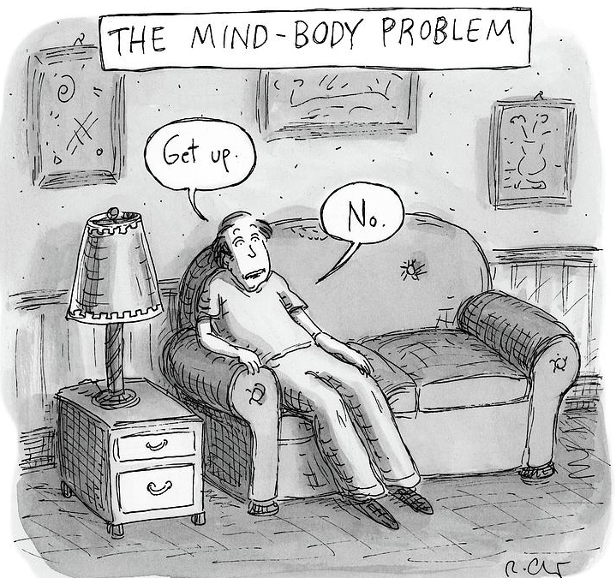
Mind-Body Problem
What is the relationship between the mind and the body (especially the brain)?
Do our thoughts, feelings, and consciousness come entirely from physical processes, or is there something extra? Is the mind some other kind of “stuff”?
Dualism: Mind and body are fundamentally different things. The body is physical, the mind is immaterial.
Materialism: Only physical matter exists. The mind is what the brain does. Mental states are brain states.
Notes:
The Interaction Problem (for dualism):
If the mind isn’t physical, how can it push atoms around in the brain?
The Qualia/Consciousness Problem (for materialism):
Even if brain processes explain behavior, why do they feel like something from the inside?

Slide 5
Mind-Body Problem
Why this question matters
Neuroscience: What counts as a good explanation of thought or emotion?
Psychology: Can mental concepts like belief and desire be reduced to biology?
Ethics and law: Can we hold people (or machines) responsible for their actions?
Artificial Intelligence: If a machine solves problems, speaks fluently, or even forms goals—does it have a mind? What kind?
Notes:
It’s not just abstract philosophy—this problem touches psychology, neuroscience, AI, religion, and ethics.
It’s about whether “explaining the brain” will ever be enough to explain you.

Slide 6
Mind-Body Solutions
Two Dimensions of Disagreement
Ontological Dependence: Is the mind a different kind of “stuff” than the physical, material world?
Explanatory Separability: Can we understand the physical and the mental independently (whatever they are made of)?
 |  | Ontologically Dependent?
 |  | Yes | No
Explanatorily Separable | Yes | 4 | 1
 | No | 2 | 3

Slide 7
Mind-Body Solutions: Quadrant 1
 |  | Ontologically Dependent?
 |  | Yes | No
Explanatorily Separable | Yes |  | 1
 | No
Definition: Mind is metaphysically distinct from the body, and best explained on its own terms.
Pros:
Explains introspective experience without reference to biology.
Intuitive appeal: consciousness feels different than brain activity.
Historically widespread
Cons:
Difficult to test scientifically.
Offers no clear mechanism for mind-body interaction.
Often relies on religious or metaphysical assumptions.
Generally rejected by most modern scientists.

Slide 8
Mind-Body Solutions: Quadrant 1
 |  | Ontologically Dependent?
 |  | Yes | No
Explanatorily Separable | Yes |  | 1
 | No
Definition: Mind is metaphysically distinct from the body, and best explained on its own terms.
Example: Substance Dualism
The idea that mind and body are two completely different kinds of stuff.
The body (including the brain) is physical, extended in space.
The mind (or soul) is non-physical, thinking but not extended in space.
Problem: How do two radically different substances interact?

Slide 9
Mind-Body Solutions: Quadrant 1
 |  | Ontologically Dependent?
 |  | Yes | No
Explanatorily Separable | Yes |  | 1
 | No
Definition: Mind is metaphysically distinct from the body, and best explained on its own terms.
Example: Idealist Monism
The idea that only mind exists, and the physical world is somehow a construction of or within mind.
Reality is ultimately mental; what we call “matter” is just patterns in experience or thought.
Problem: If everything is mental, why does the world seem to follow physical laws independently of us?

Slide 10
Mind-Body Solutions: Quadrant 1
 |  | Ontologically Dependent?
 |  | Yes | No
Explanatorily Separable | Yes |  | 1
 | No
Definition: Mind is metaphysically distinct from the body, and best explained on its own terms.
Example: Pansychism
The view that consciousness is a basic feature of the universe, present in some form even in very simple things (like atoms or particles).
Even rocks are a “little bit” conscious
Problem: If everything has some form of consciousness, how do tiny “micro-consciousnesses” combine into the unified, complex consciousness that humans experience? (This is called the “combination problem.”)

Slide 11
Mind-Body Solutions: Quadrant 2
 |  | Ontologically Dependent?
 |  | Yes | No
Explanatorily Separable | Yes
 | No | 2
Definition: Mind is metaphysically the same as the body, and mind and body are not separately explainable.
Pros:
Fully naturalistic—no mystery substances.
Fits well with neuroscience methods.
Simpler, more parsimonious ontology.
Cons:
Struggles to explain subjective experience (qualia).
Hard to capture intentionality and reasoning in physical terms.
Eliminates familiar mental concepts like “belief” or “desire.”
Often seen as too reductionist for psychology or AI.

Slide 12
Mind-Body Solutions: Quadrant 2
 |  | Ontologically Dependent?
 |  | Yes | No
Explanatorily Separable | Yes
 | No | 2
Definition: Mind is metaphysically the same as the body, and mind and body are not separately explainable.
Example: Identity Theory
Mental states (like pain, joy, fear) are identical to brain states — e.g., “pain just is C-fiber firing.”
Every kind of mental state maps onto a specific kind of physical state in the brain.
Problem: This view struggles with the “multiple realizability” objection: if an alien or AI can feel pain without C-fibers, then pain can’t be identical to that brain state.

Slide 13
Mind-Body Solutions: Quadrant 2
 |  | Ontologically Dependent?
 |  | Yes | No
Explanatorily Separable | Yes
 | No | 2
Definition: Mind is metaphysically the same as the body, and mind and body are not separately explainable.
Example: Eliminative Materialism
Our everyday mental concepts (“beliefs,” “desires,” “feelings”) are a flawed “folk psychology”.
As neuroscience advances, these commonsense terms will be eliminated and replaced by precise neuroscientific ones, the way “phlogiston” was replaced in chemistry.
Problem: It seems self-refuting — to argue for eliminativism, you have to use beliefs and desires (you believe eliminativism is true, you desire to persuade others).

Slide 14
Mind-Body Solutions: Quadrant 3
 |  | Ontologically Dependent?
 |  | Yes | No
Explanatorily Separable | Yes
 | No |  | 3
Definition: Mind and physical systems are independent kinds of stuff, but must understand both of them to explain each one.
Pros:
Maintains a separate status for the mental (if you value that)
Cons:
Interaction problem squared
Pretty much all the problems of all the others put together

Slide 15
Mind-Body Solutions: Quadrant 4
 |  | Ontologically Dependent?
 |  | Yes | No
Explanatorily Separable | Yes | 4
 | No
Definition: Mind depends on physical systems, but can sometimes be explained in terms that are not reduced to physical ones.
Pros:
Allows for useful psychological explanations.
Supports interdisciplinary research (neuroscience, AI, psychology).
Handles multiple realizability: different systems (human, machine) can support similar mental states.
Cons:
Critics may say it’s vague or fence-sitting.
Requires care to avoid incoherent dual-aspect metaphysics.
Still debated: what “level” is real?

Slide 16
Mind-Body Solutions: Quadrant 4
 |  | Ontologically Dependent?
 |  | Yes | No
Explanatorily Separable | Yes | 4
 | No
Definition: Mind depends on physical systems, but can sometimes be explained in terms that are not reduced to physical ones.
Example: Functionalism
What makes something a mental state is what it does, not what it’s made of. Pain = the state that’s caused by injury and leads to avoidance, regardless of whether it’s in a brain, a robot, or an alien.
Mental states are defined by their functions or roles in a system, not their physical substance.
Problem: It struggles with qualia — explaining why these functional roles are accompanied by felt experience (“what it’s like” to be in pain).

Slide 17
Mind-Body Solutions: Quadrant 4
 |  | Ontologically Dependent?
 |  | Yes | No
Explanatorily Separable | Yes | 4
 | No
Definition: Mind depends on physical systems, but can sometimes be explained in terms that are not reduced to physical ones.
Example: Emergentism
Mental phenomena emerge from complex physical systems like the brain, the way liquidity emerges from H₂O molecules.
The mind is not separate from the brain, but it has new properties that aren’t reducible to the properties of neurons.
Problem: Critics ask whether “emergence” really explains anything — or if it’s just a label for our ignorance about how brain activity produces cognition.

Slide 18
Mind-Body Solutions: Quadrant 4
 |  | Ontologically Dependent?
 |  | Yes | No
Explanatorily Separable | Yes | 4
 | No
Definition: Mind depends on physical systems, but can sometimes be explained in terms that are not reduced to physical ones.
Example: Multiple Levels of Analysis
To understand the mind, we must explain it at different levels:
Each level gives a valid, necessary kind of explanation; no single level captures the whole picture.
Problem: How do we connect the levels? For example, how do abstract computations (like vision) map onto specific neural processes?

Slide 19
Mind-Body Solutions: Quadrant 4
The Popularity of Quadrant 4:
Still materialist and scientific (as opposed to quadrant 1 and 3)
Psychological explanations work
Theoretical limitations: can you really eliminate all talk of memory, attention, concepts?
Most sciences are reductive without being eliminativist
Practical constraints. modeling in terms of neurons is intractable
Multiple realizability

